Slide 1
My family is my Treasure
Tuesday, the 16th of June

Slide 2
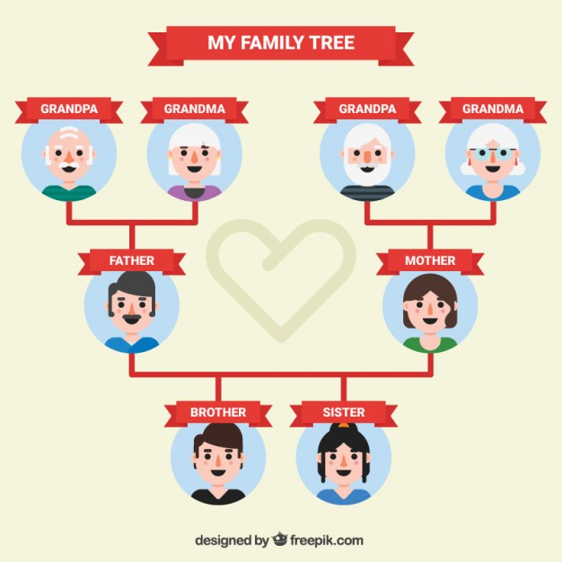
Focus on vocabulary
Let’s remember the words connect with family

Slide 3
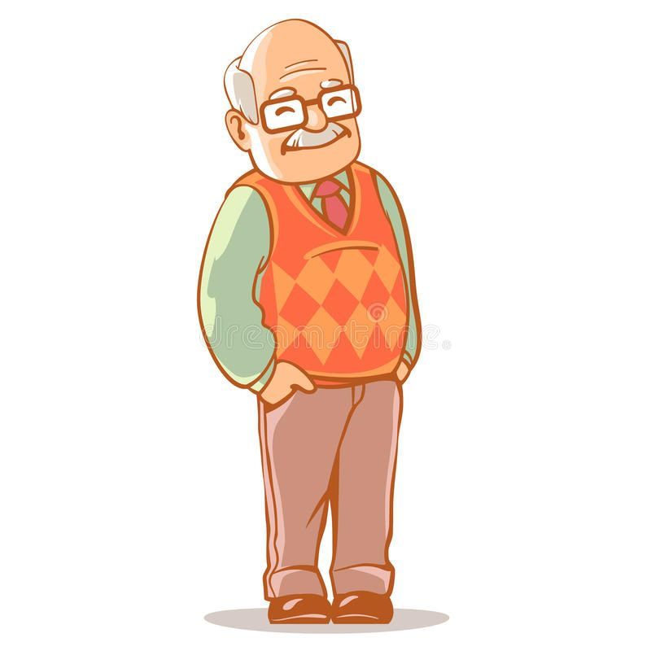
Who is it?
It is my G……….

Slide 4
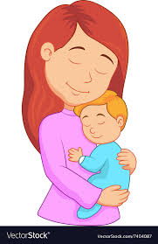
Who is it?
It is my M…..

Slide 5
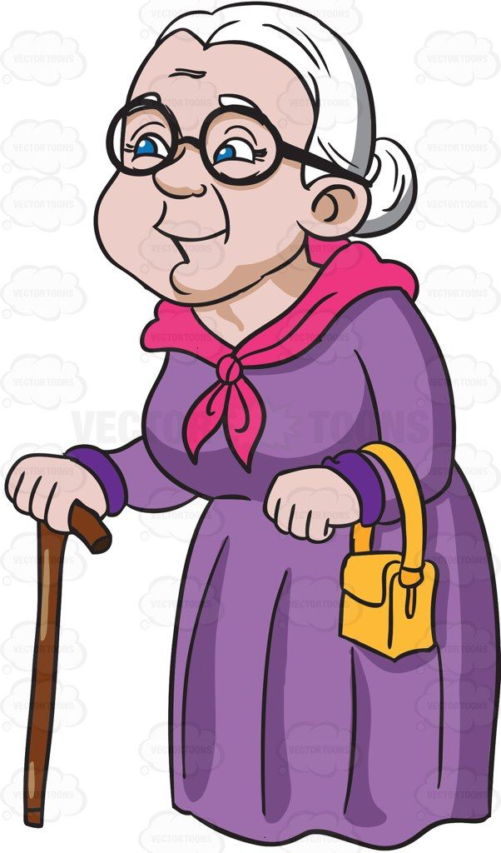
Who is it?
It is my G……….

Slide 6
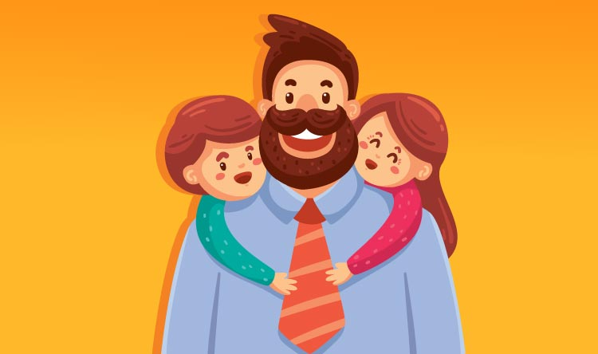
Who is it?
It is my F…..

Slide 7
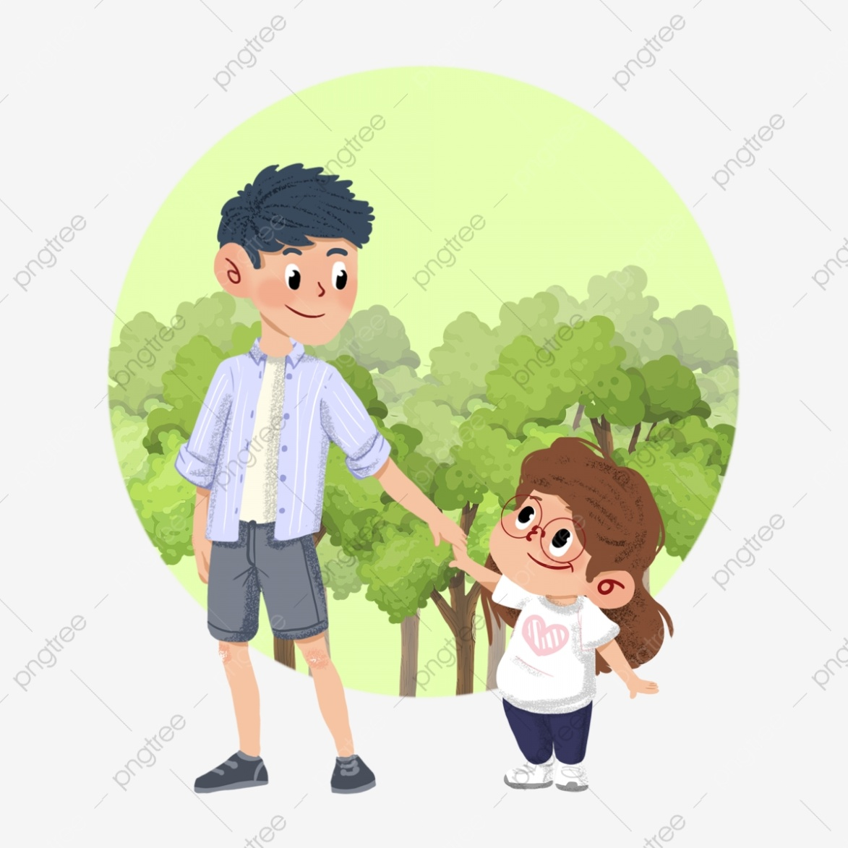
Who is it?
It is my S…..

Slide 8
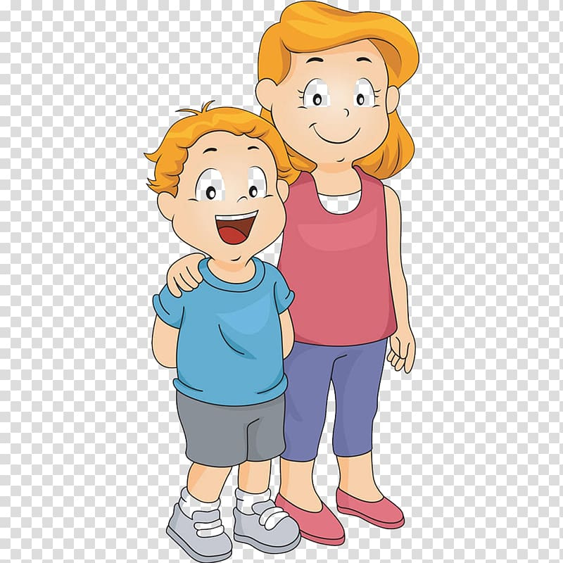
Who is it?
It is my B……

Slide 9
1. A girl who has the same parents as you? _____________ 2. Two babies born at the same time? __________________ 3. the brother of your father or mother? ______________ 4. A child of your aunt and uncle? ____________________ 5. A parent of your mother or father? _________________ 6. A son of your brother or sister? ___________________ 7. A male parent? _________________________________ 8. Sister of your mother or sister? ___________________ 9. A female parent? _______________________________ 10. Group of people who are living together? ___________
Guess family members

Slide 10
Focus on Grammar
Вставьте пропущенные глаголы To Be (Am, Is, Are)

Slide 11
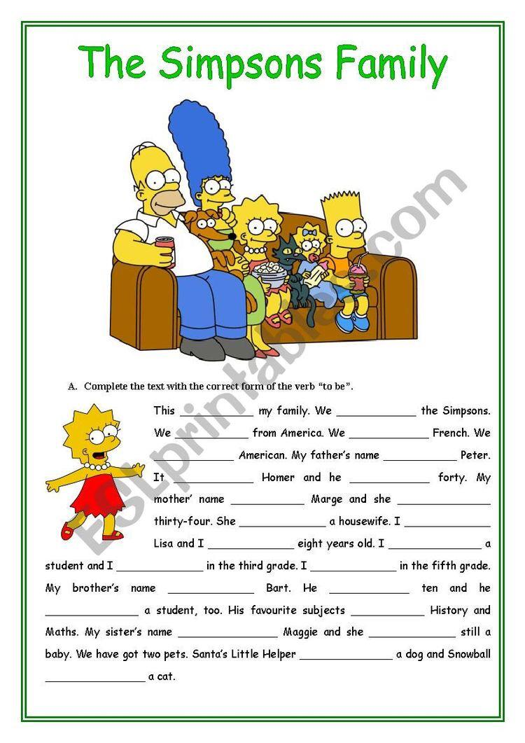

Slide 12
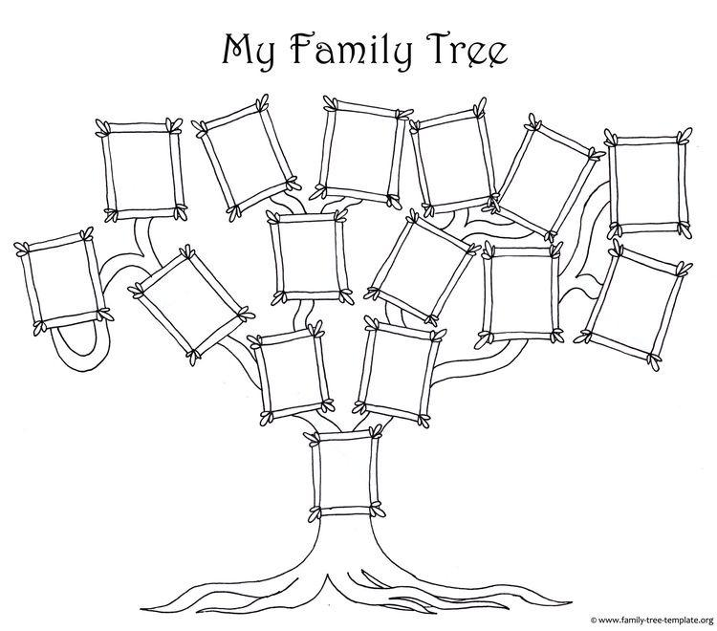
Draw your family tree Нарисуйте семейное дерево

